Slide 1
YACHI Map
Project Description
408850435 盧佳馨
408850260 楊思妤
408850112 劉姿妤

Slide 2
What we think
In Yilan,we always see tourists everywhere during weekend,and sometimes they asks us for what's good to eat, where's good to go,etc.Since that, we come up with the idea that how about we make a simple website for them to search for food.In this website,we focus on Jiaoxi Night Market.And the website provide information such as the whole map of Jiaoxi Night Market, the menu of each stall, and the basic introduction of the stall.
We also make the registration mechanism so that the stall owner can upload their newest information.

Slide 3
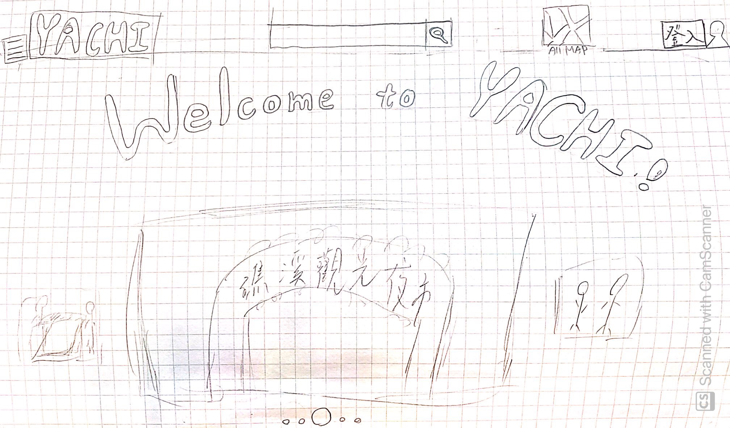
首頁

Slide 4
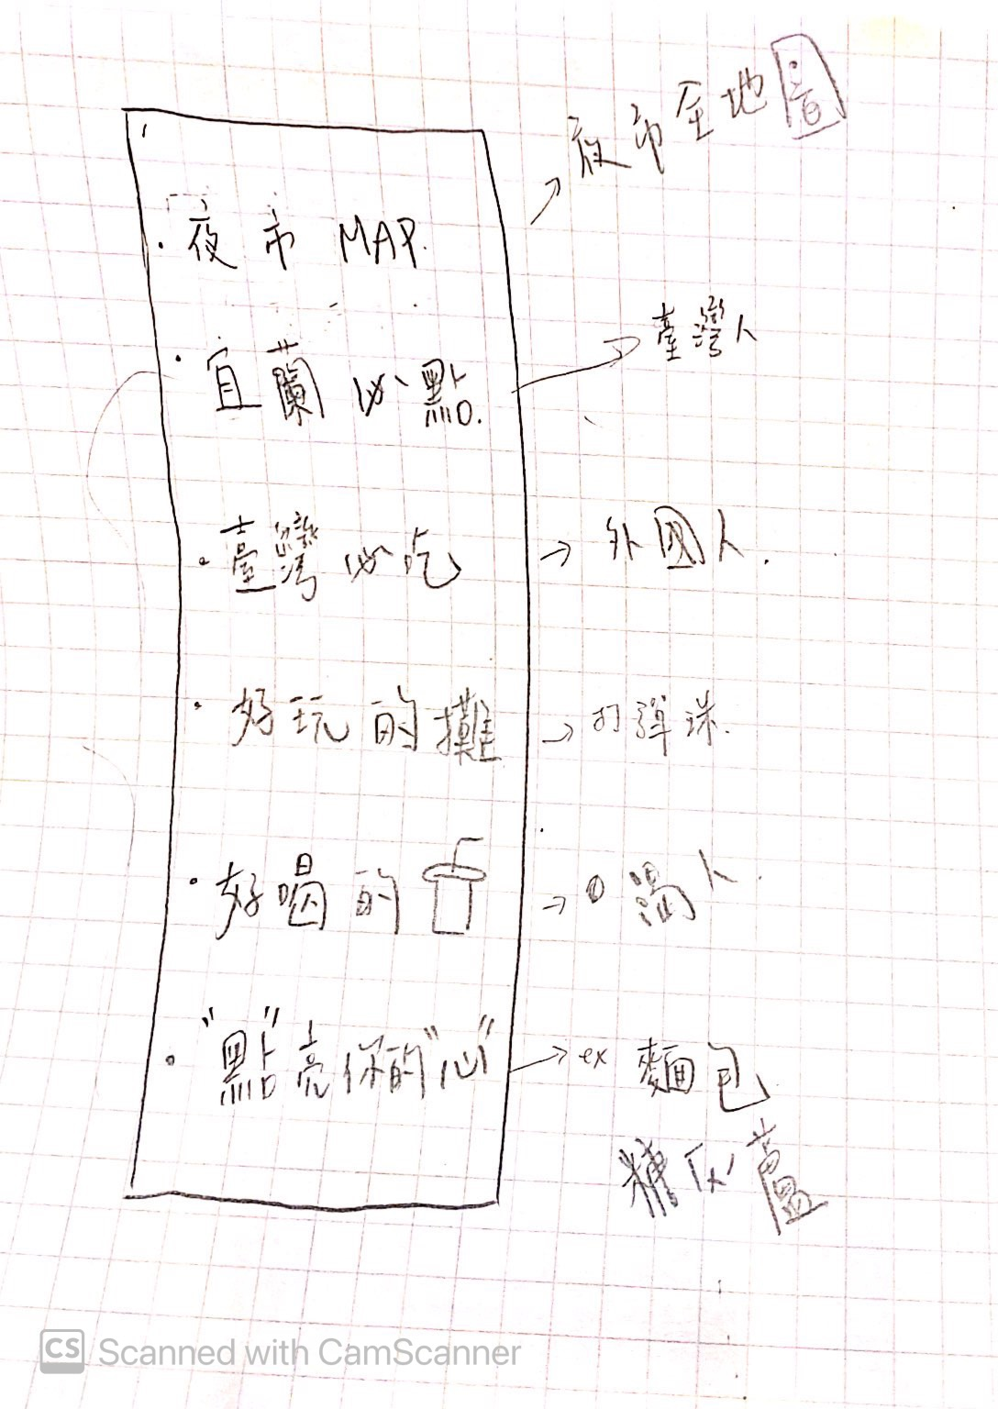
選單(點選首頁YACHI旁的選單圖示鈕會跑出來)

Slide 5
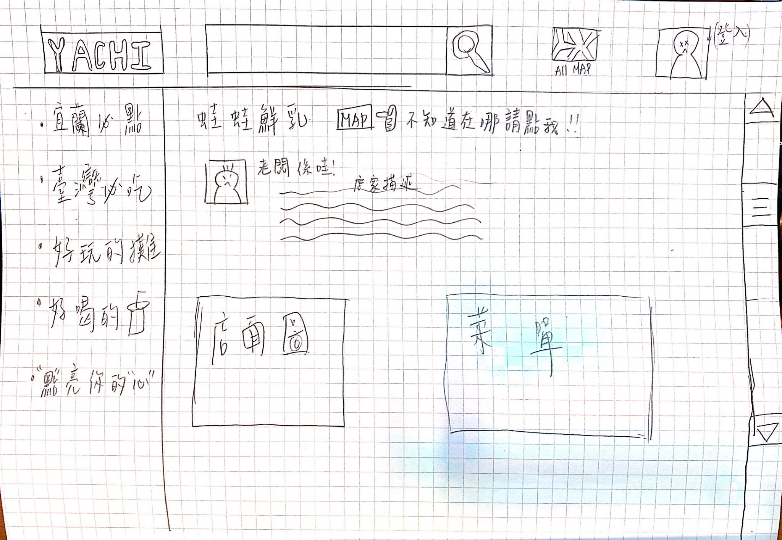
攤販簡介

Slide 6
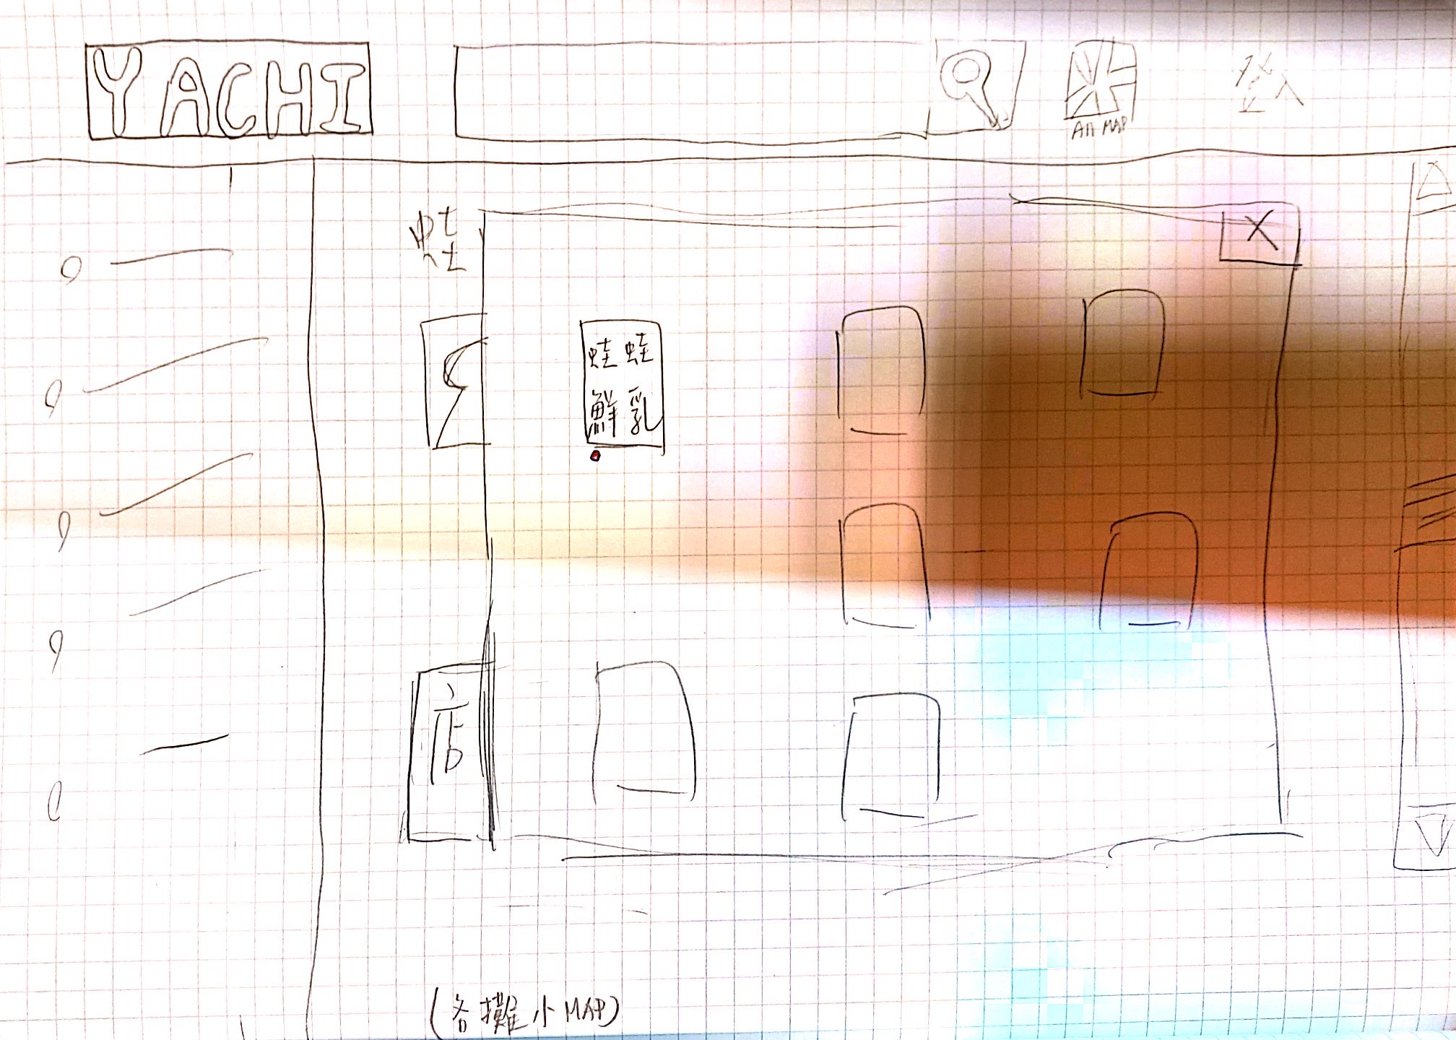
各攤小地圖(點選攤販簡介的MAP按鈕後會跑出來)

Slide 7
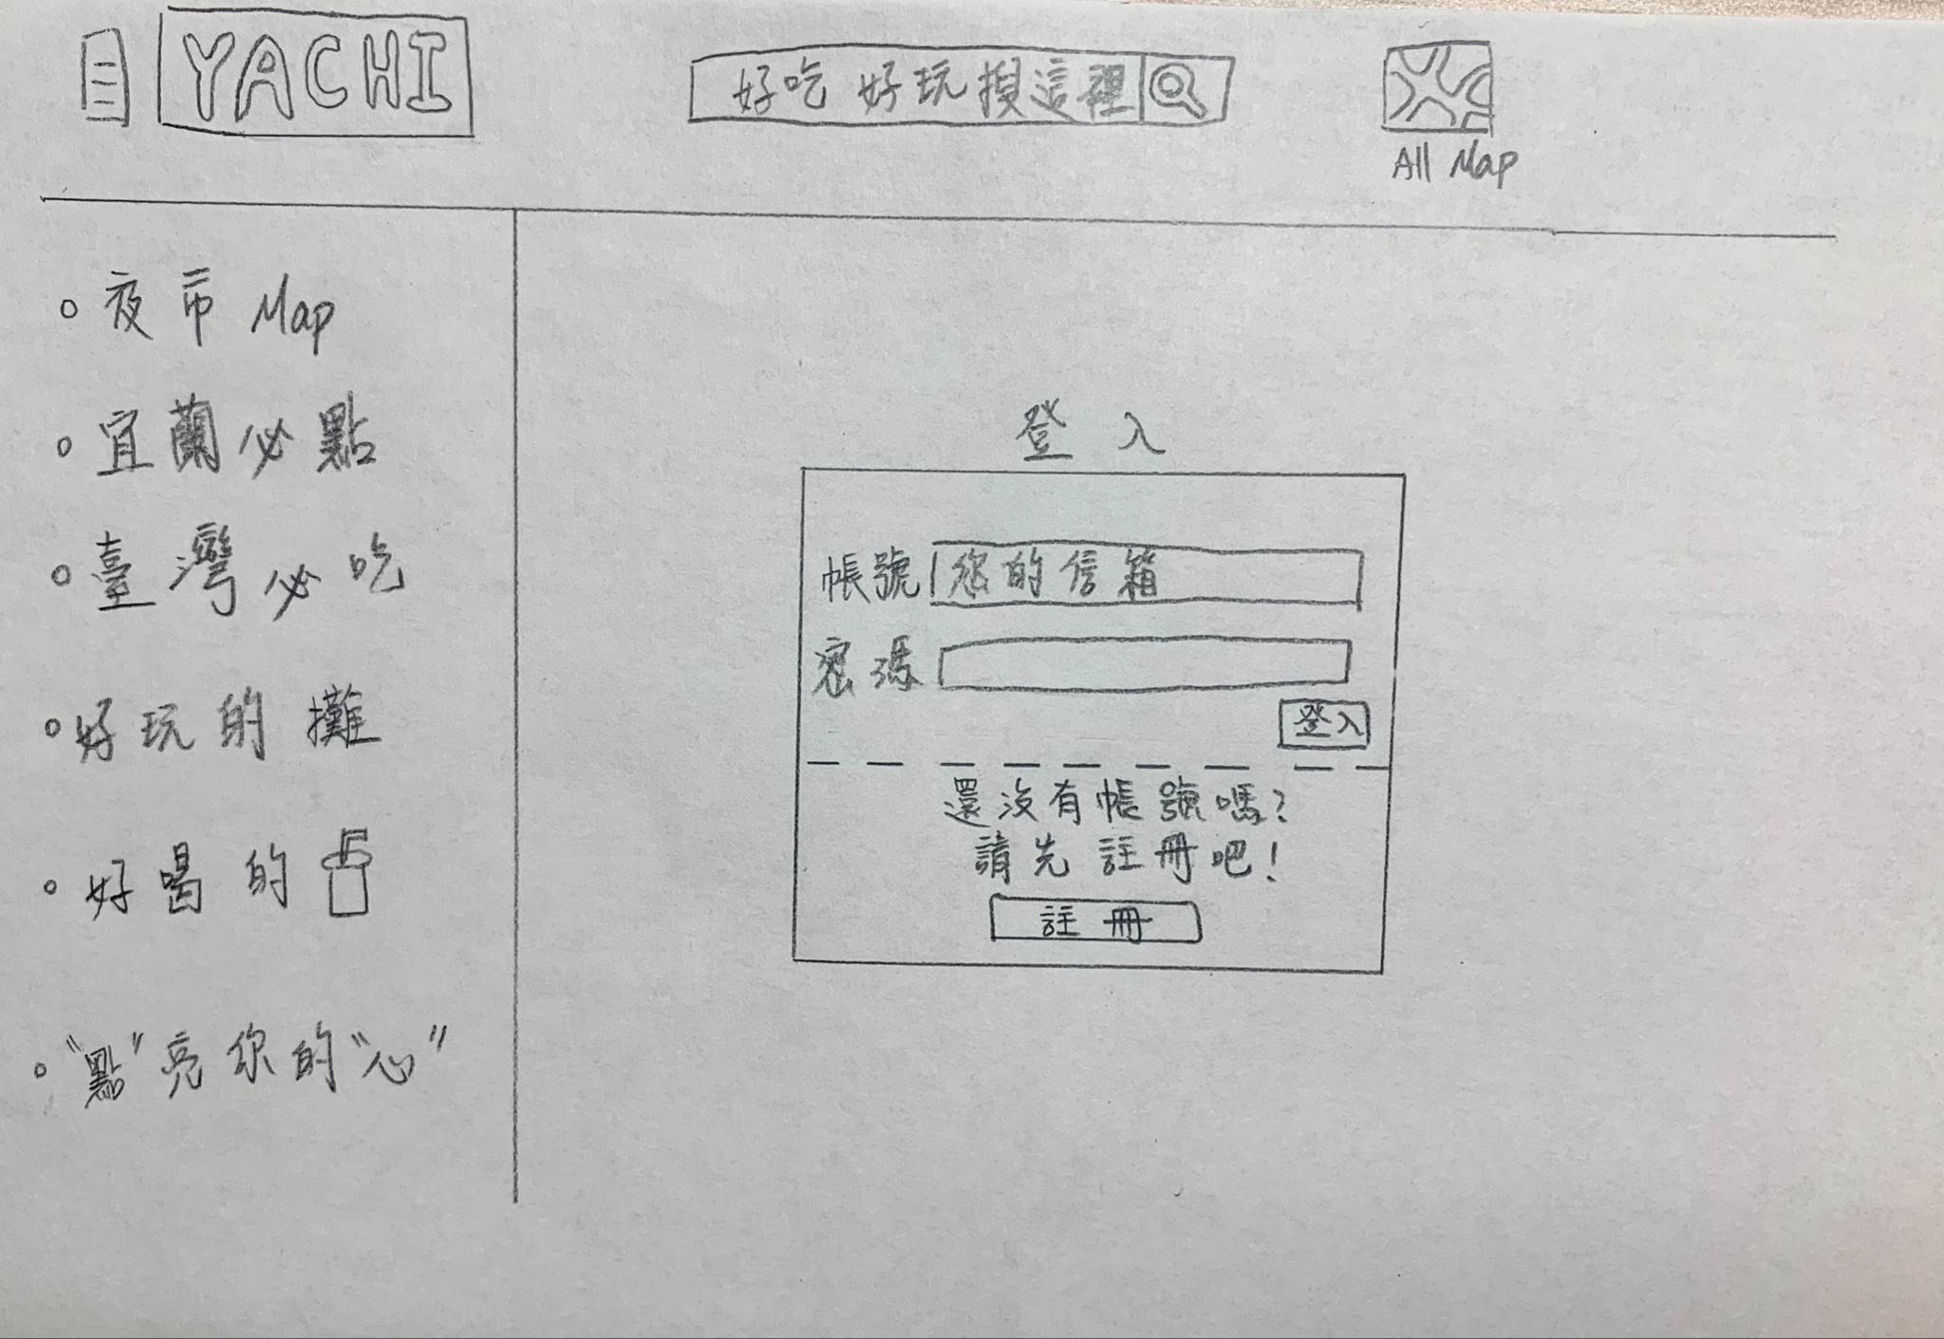
(登入)

Slide 8
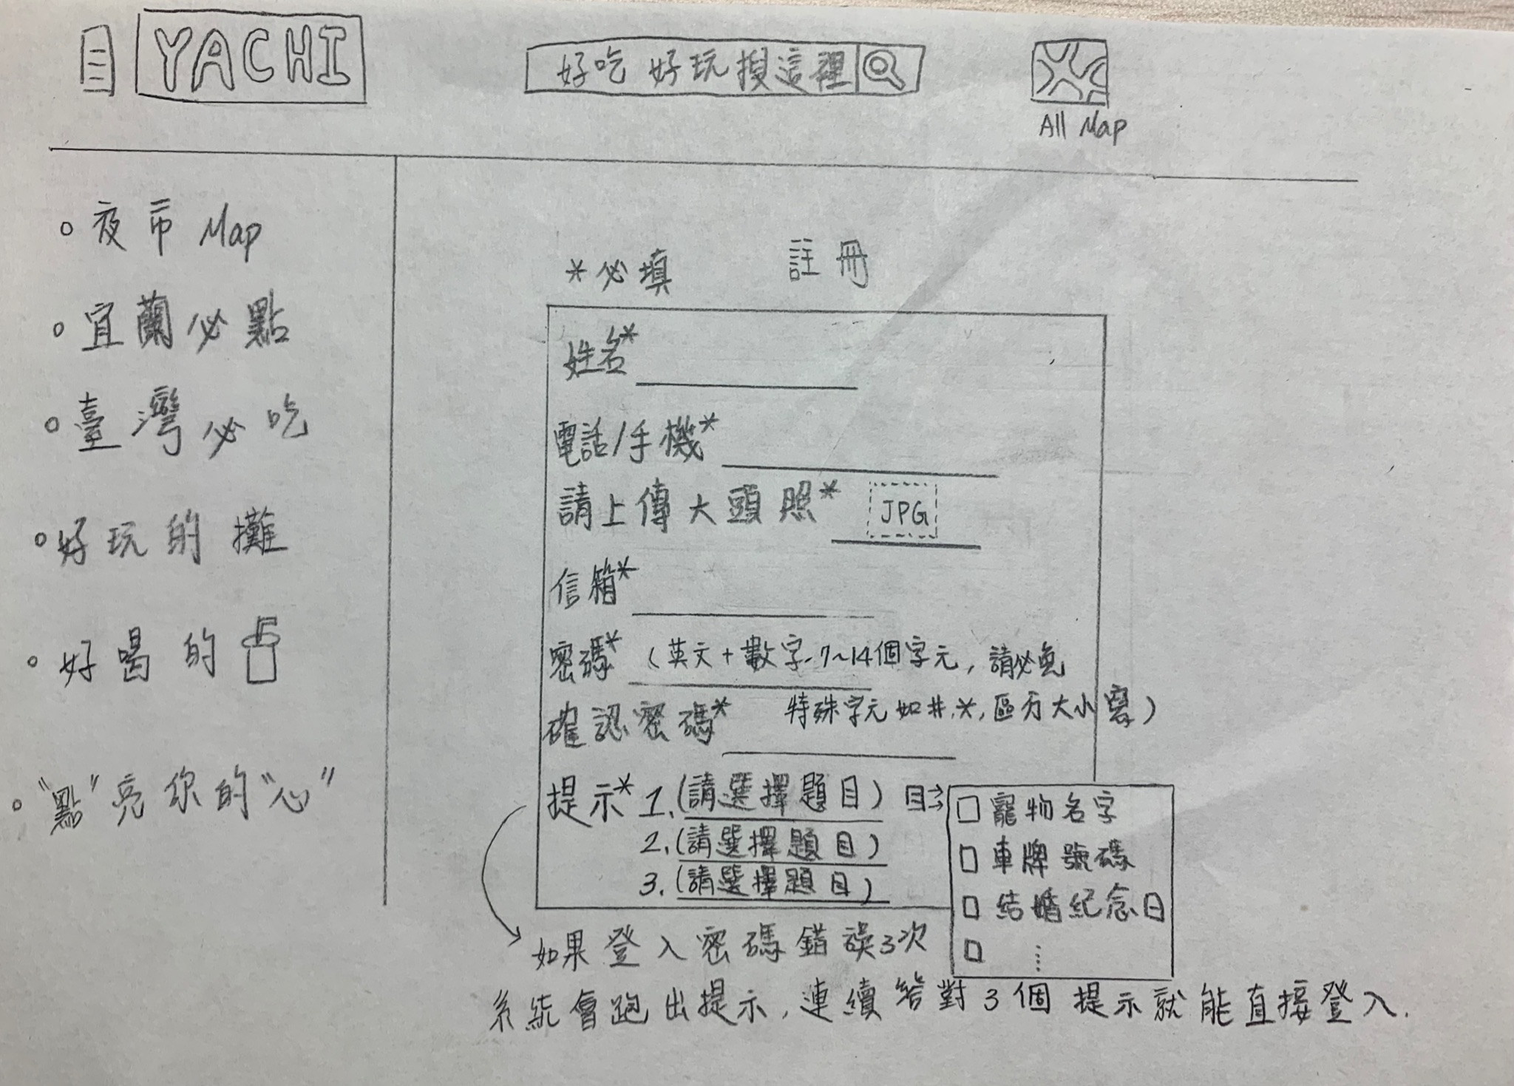
(註冊)

Slide 9
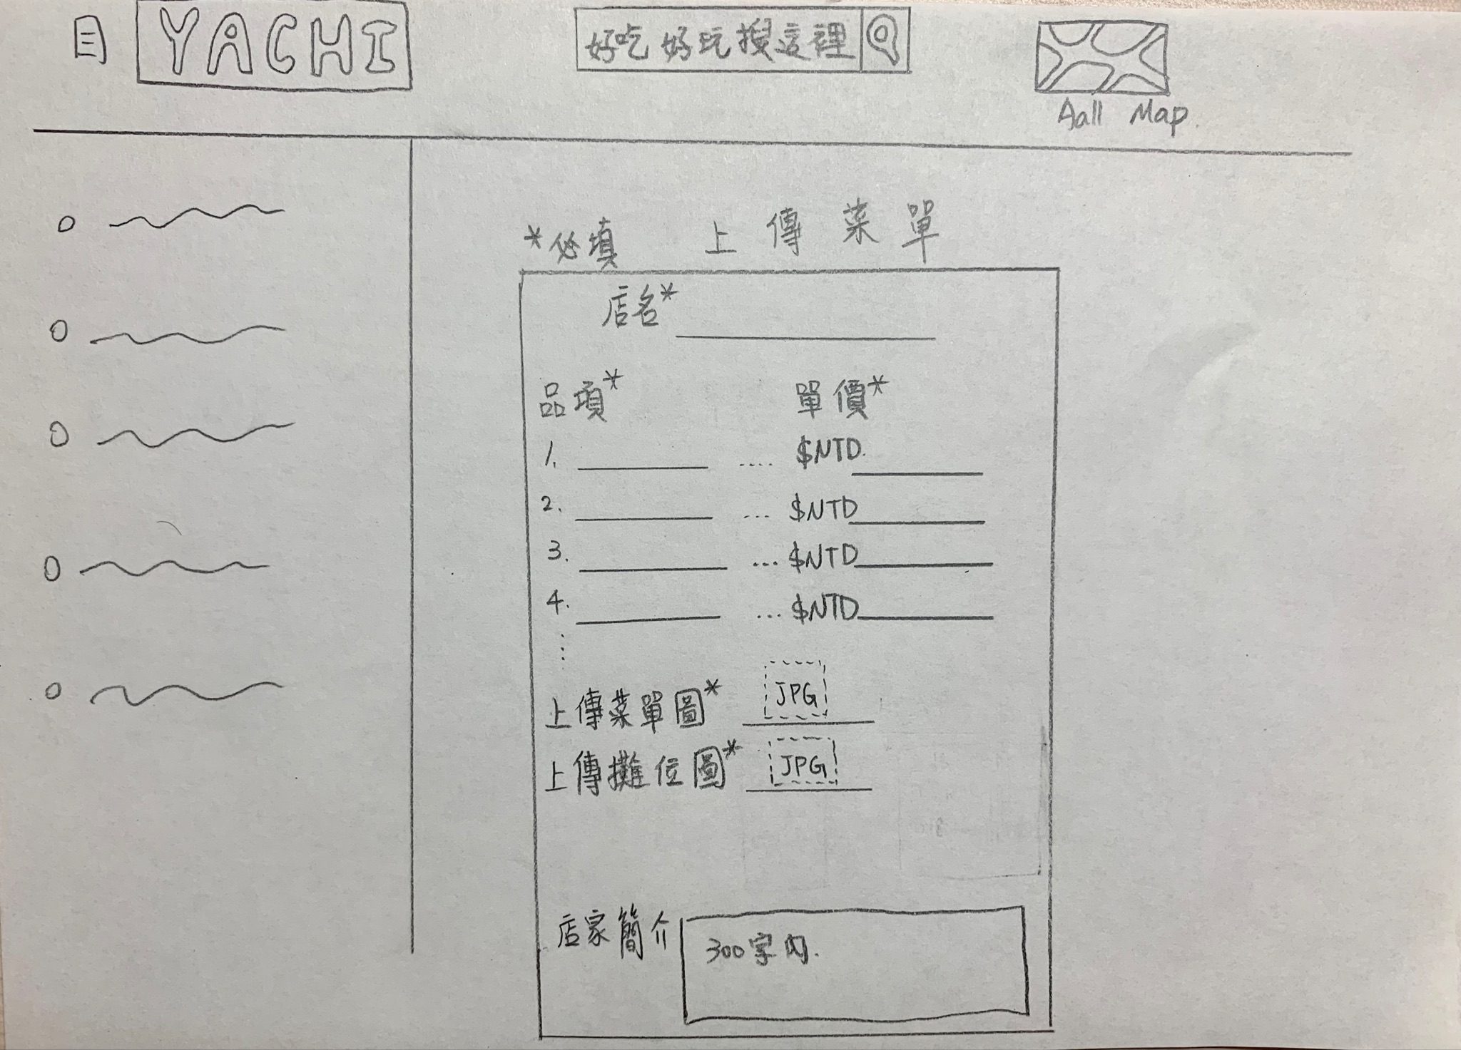
(上傳菜單)

Slide 10
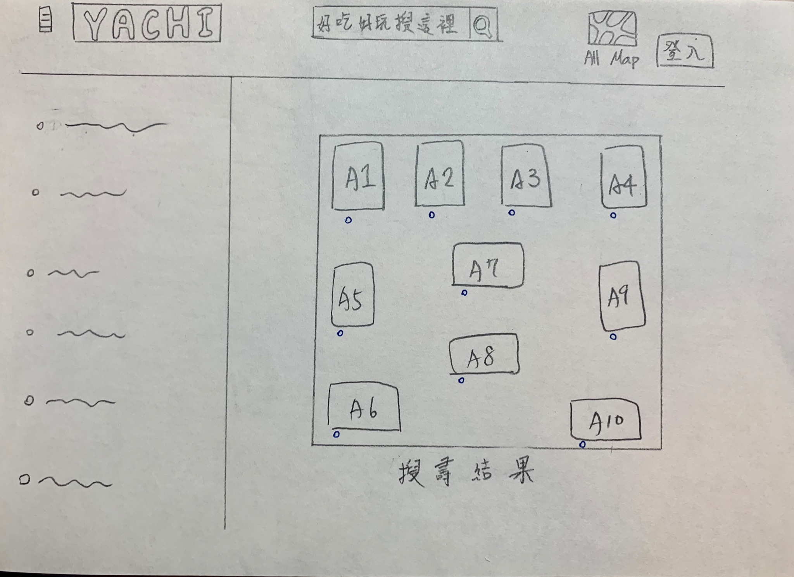
搜尋結果（符合搜尋關鍵字的攤位會亮燈）

Slide 11
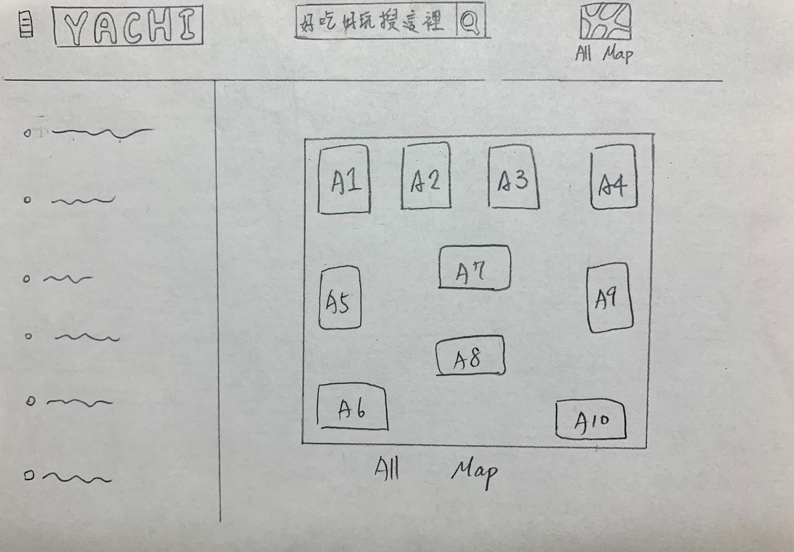
全地圖

